Slide 1
Nested Deploy with AVI

Slide 2
Issue I ran into on my Windows 2016 servers with the 7.0u2 ISO
7.0 u2 iso execution issues
============================
Error: VCRuntime140.dll missing or a hex number error
Download: https://www.microsoft.com/en-us/download/confirmation.aspx?id=52685

Slide 3
AVI Resources
https://vault.vmware.com/group/nsx/avi-networks-technical-resources
https://www.youtube.com/watch?v=7FKkCb8OqaY
https://docs.vmware.com/en/VMware-vSphere/7.0/vmware-vsphere-with-tanzu/GUID-AB96BE48-D5B3-4B88-A92E-5A083472C56D.html

Slide 4
AVI Downloads
https://www.vmware.com/go/get-tanzu-adv
https://portal.avipulse.vmware.com/vantage-details/602bf92b4cf2e5235df1319e
https://kb.vmware.com/s/article/82049?lang=en_US&queryTerm=nsx+advanced+load+balancer
https://my.vmware.com/group/vmware/downloads/info/slug/networking_security/vmware_nsx_advanced_load_balancer/20_1_x
https://vault.vmware.com/group/nsx/avi-networks-technical-resources -> Software Downloads

Slide 5
AVI License Vault
https://vault.vmware.com/group/vault-main-library/document-preview/-/document_library/6KC5yhh3TpWl/view_file/49534770

Slide 6
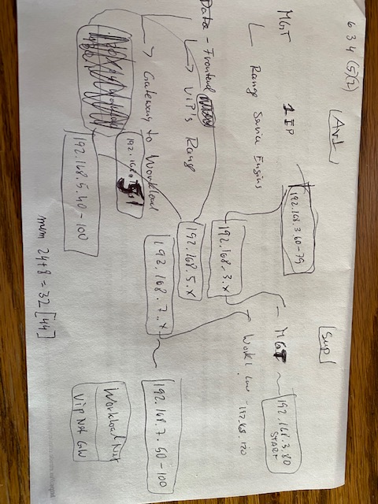
The Set up….Clear?

Slide 7
My Network layout (.3)(.5)(.7)
AVI Supervisor
192.168.3.40 (AVI) 192.168.3.x MGT .50 vCenter .51-3 ESXi
192.168.3.60-79 MGT 192.168.3.80 (Start)
192.168.5.x Front
192.168.5.40-100 Front
192.168.7.x Workload
Route 192.168.5.1 (192.168.7.0/24) Workload 192.168.7.50-100

Slide 8
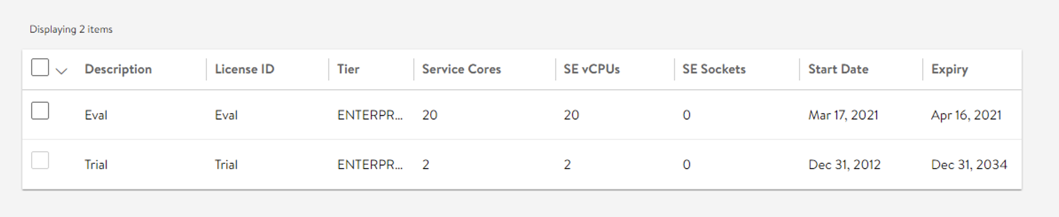
License by default

Slide 9
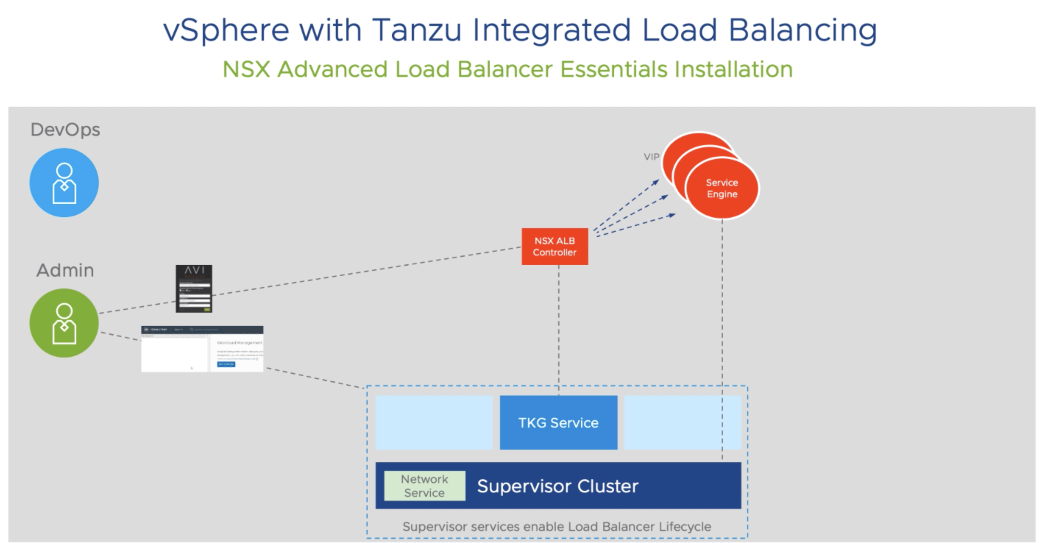
AVI Layout

Slide 10
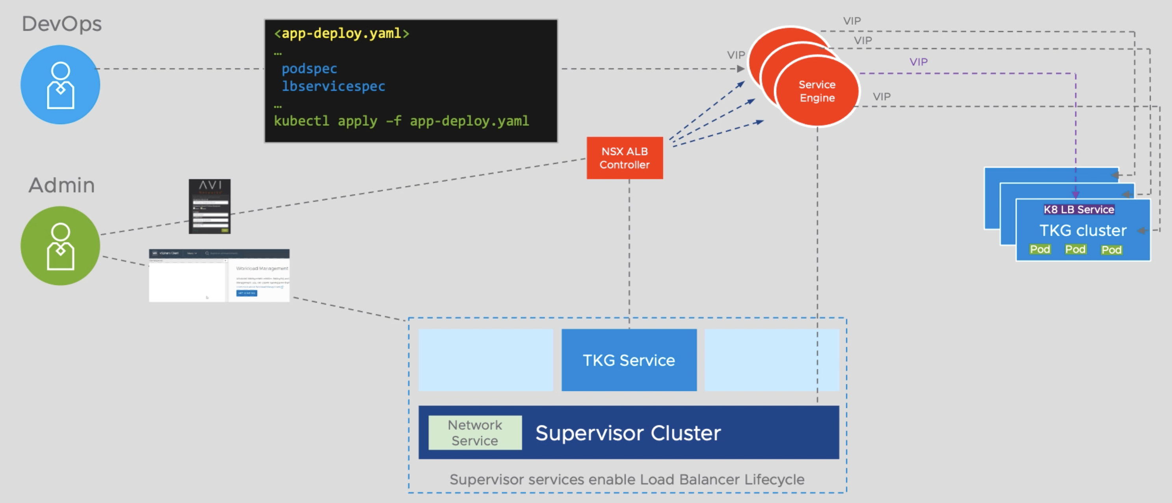
AVI Layout

Slide 11
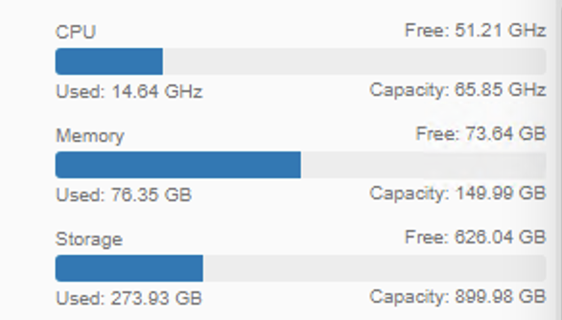
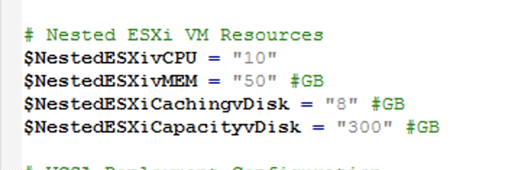
Expected Resource Consumption

Slide 12
Deploying Avi Controller OVA
Deploy OVF Template
Choose Thick Provision Lazy Zeroed for disk format.

Slide 13
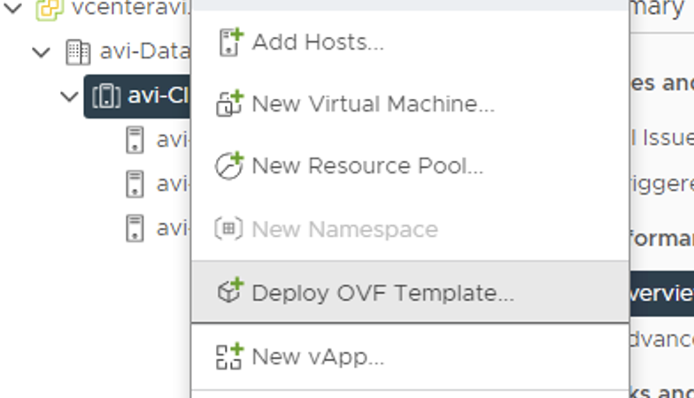
Deploying Avi Controller OVA

Slide 14
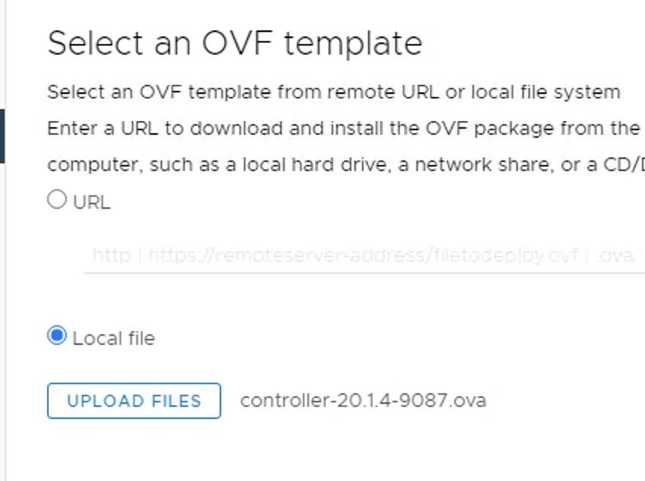
Deploying Avi Controller OVA

Slide 15
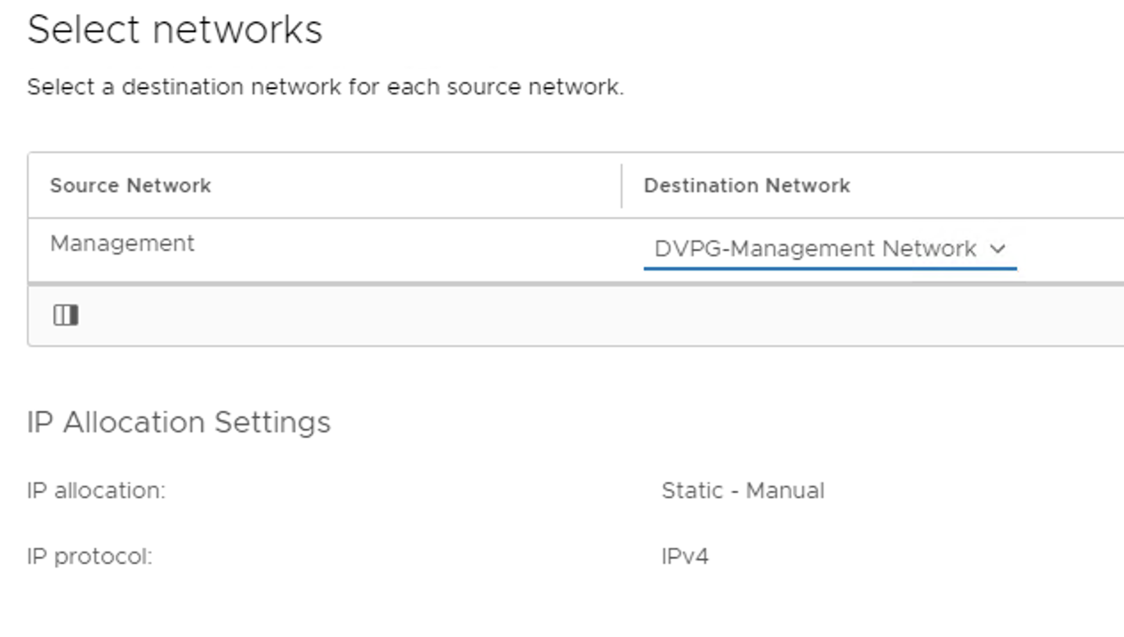
Deploying Avi Controller OVA

Slide 16
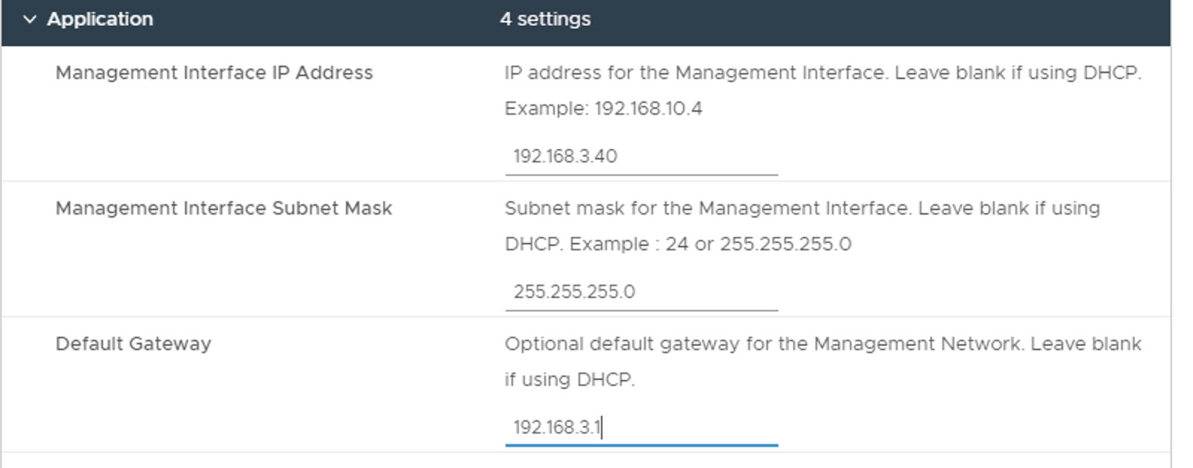
Deploying Avi Controller OVA

Slide 17
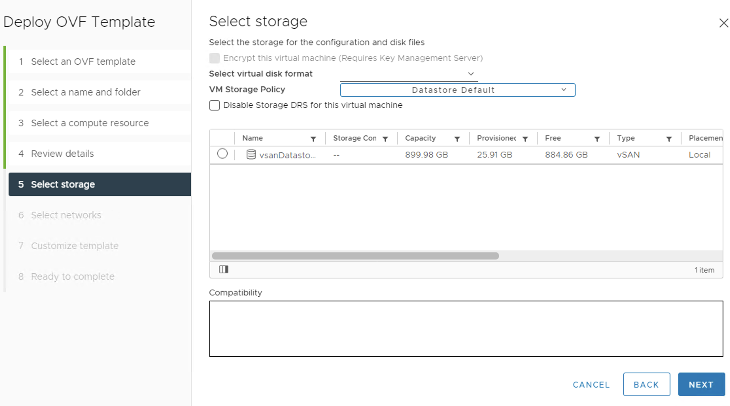
Deploying Avi Controller OVA

Slide 18
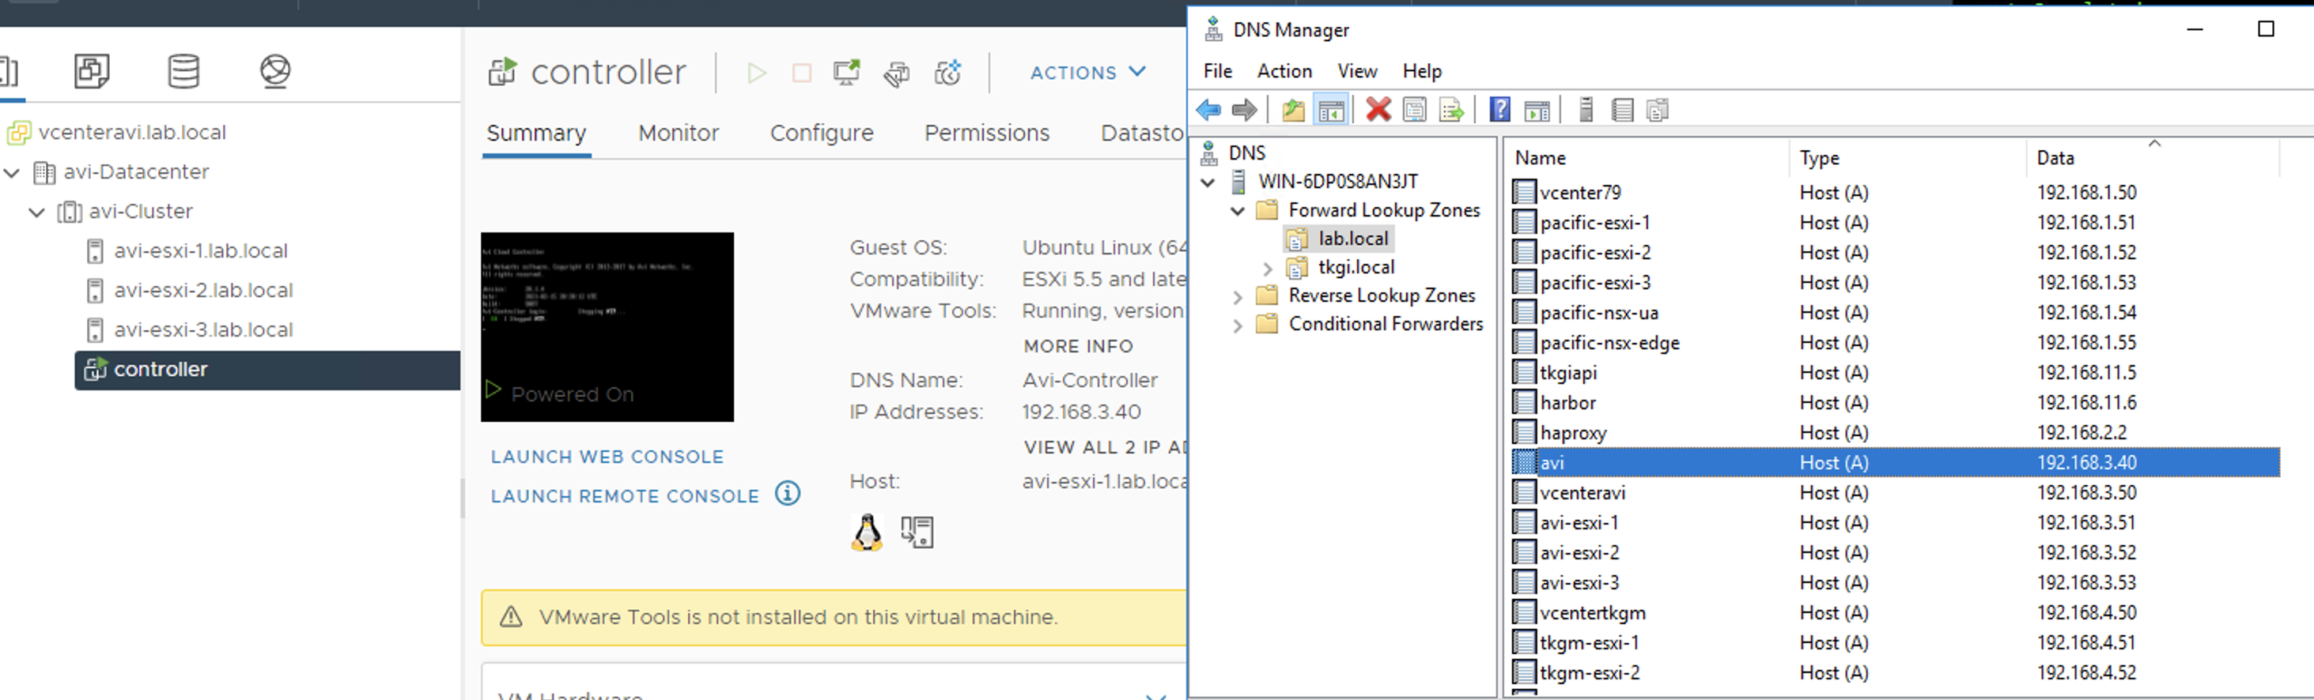
AVI 192.168.3.40 in DNS forward and reverse

Slide 19
AVI via Browser for final setup
Open browser to http://192.168.3.40
It may take a little bit before the GUI is up!

Slide 20
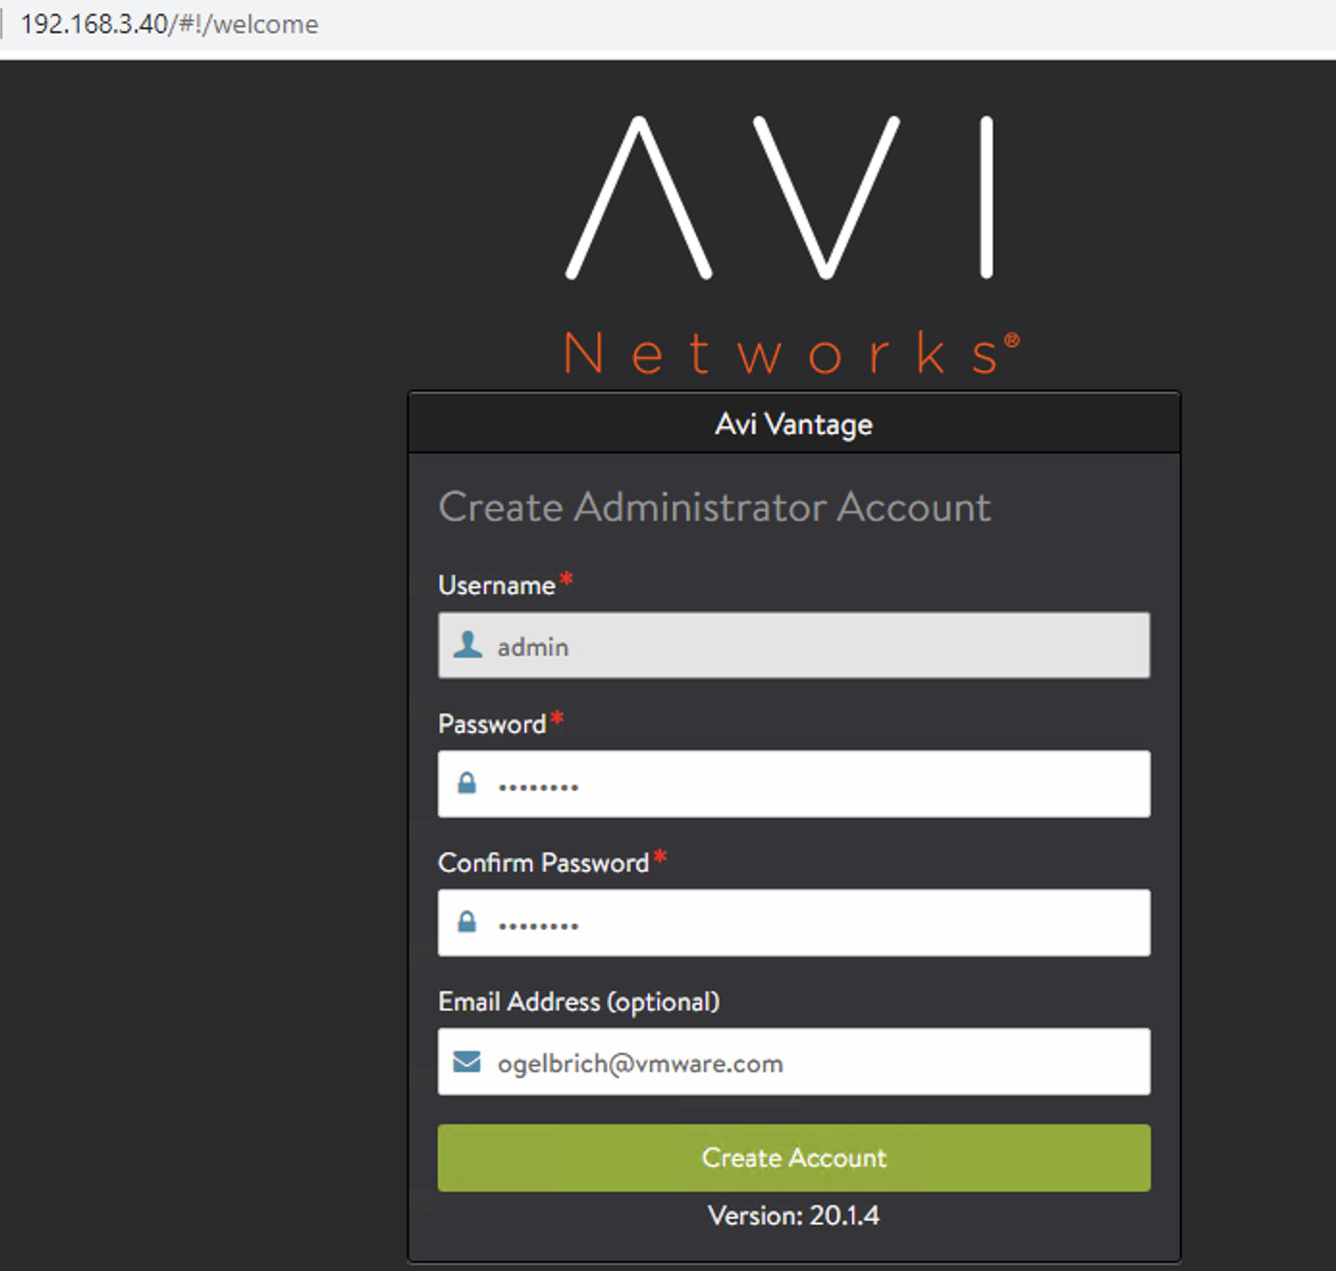
AVI initial setup

Slide 21
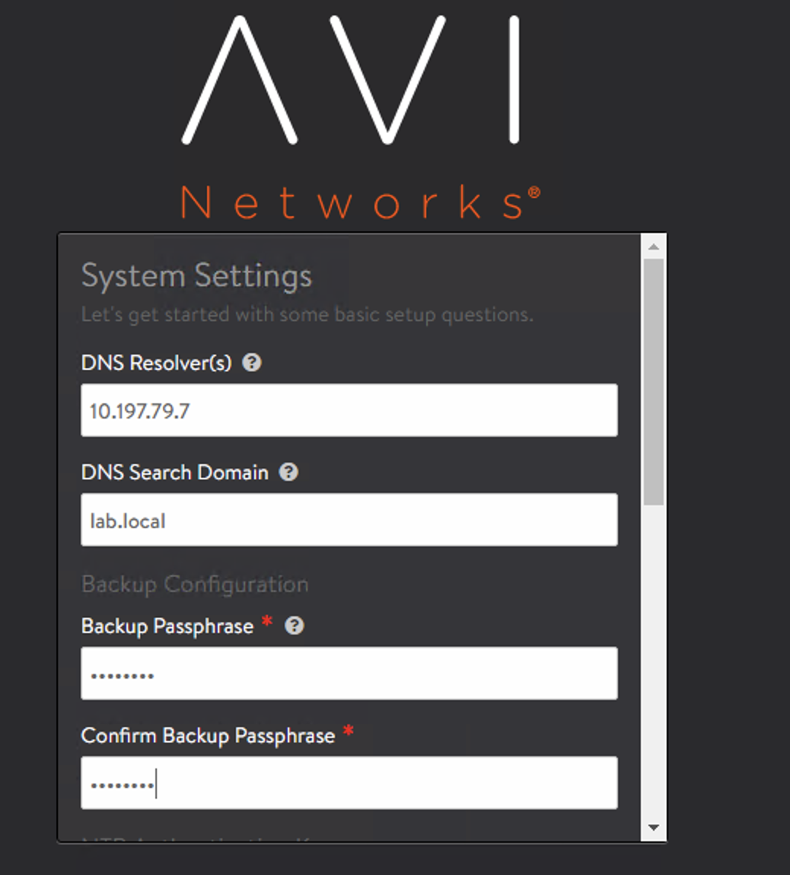
AVI initial setup

Slide 22
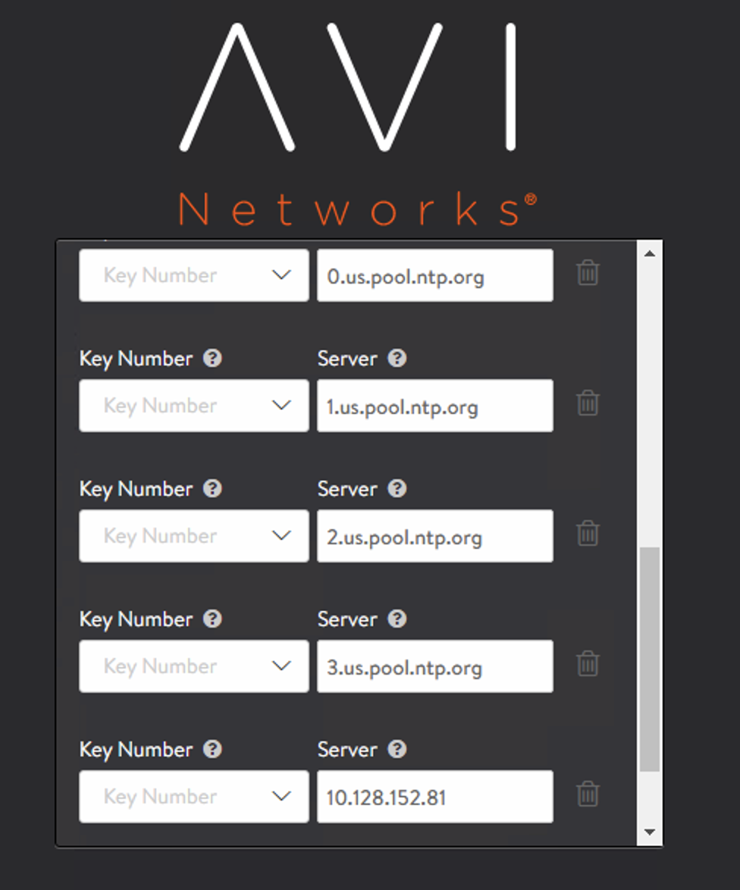
AVI initial setup

Slide 23
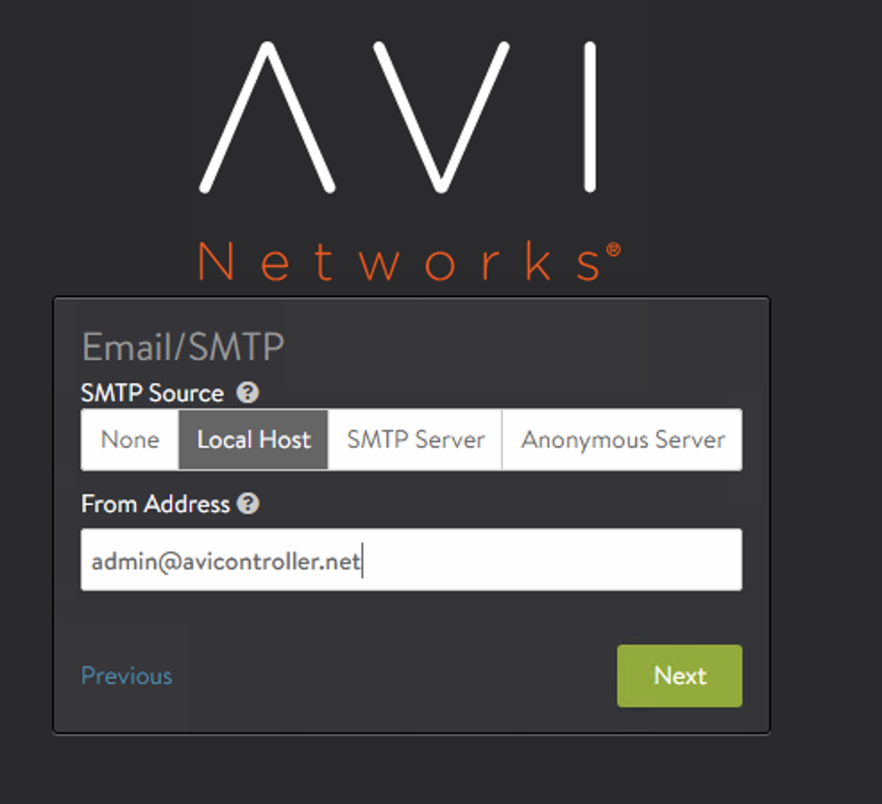
AVI initial setup

Slide 24
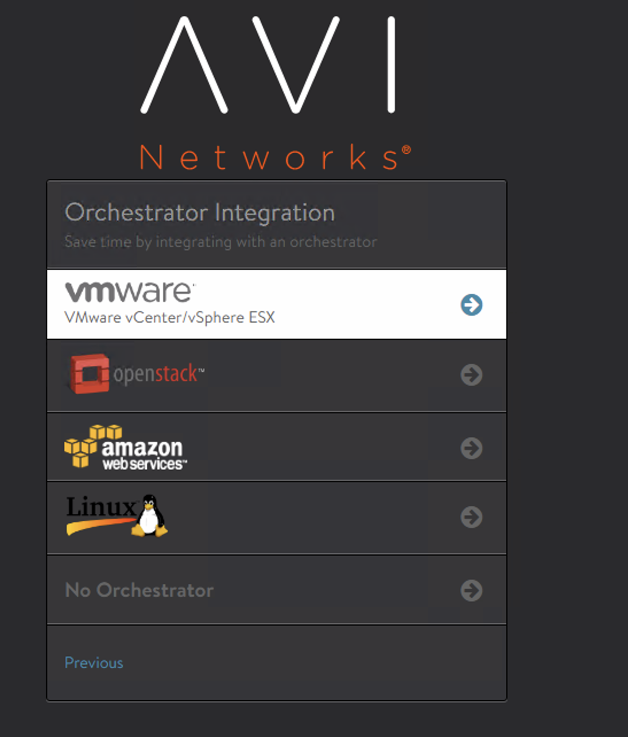
AVI initial setup

Slide 25
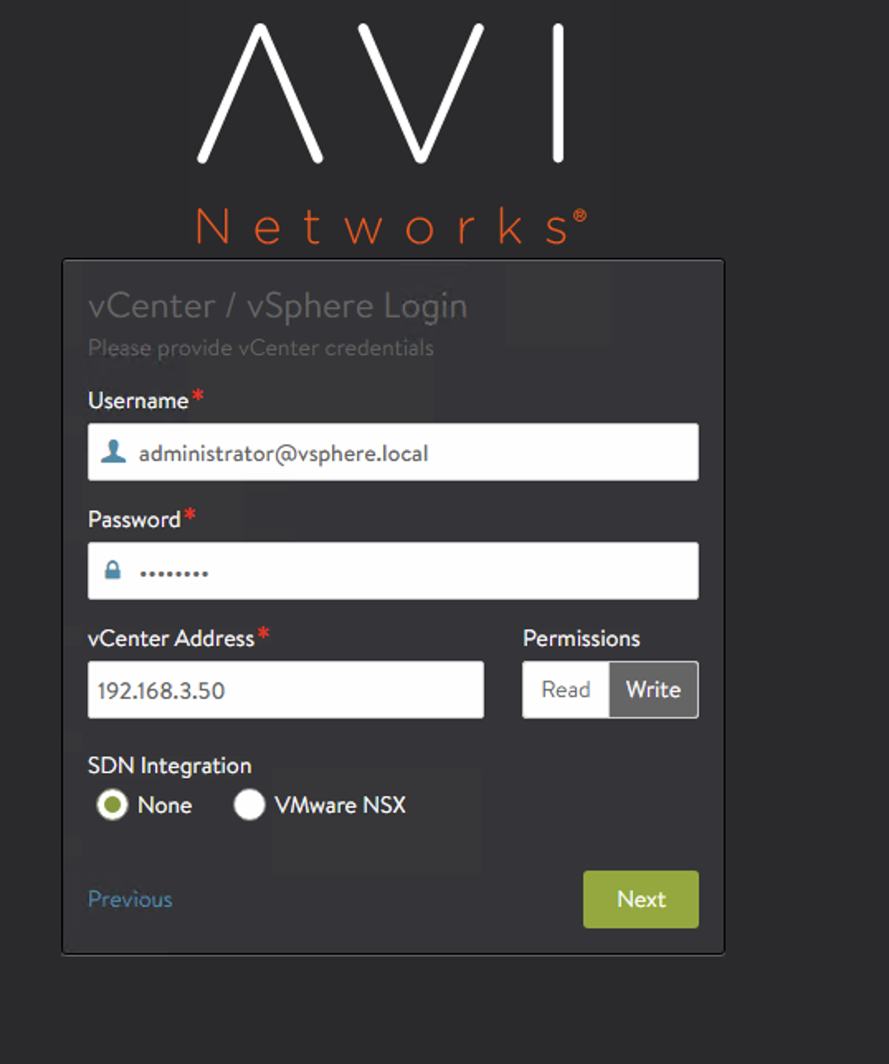
AVI initial setup

Slide 26
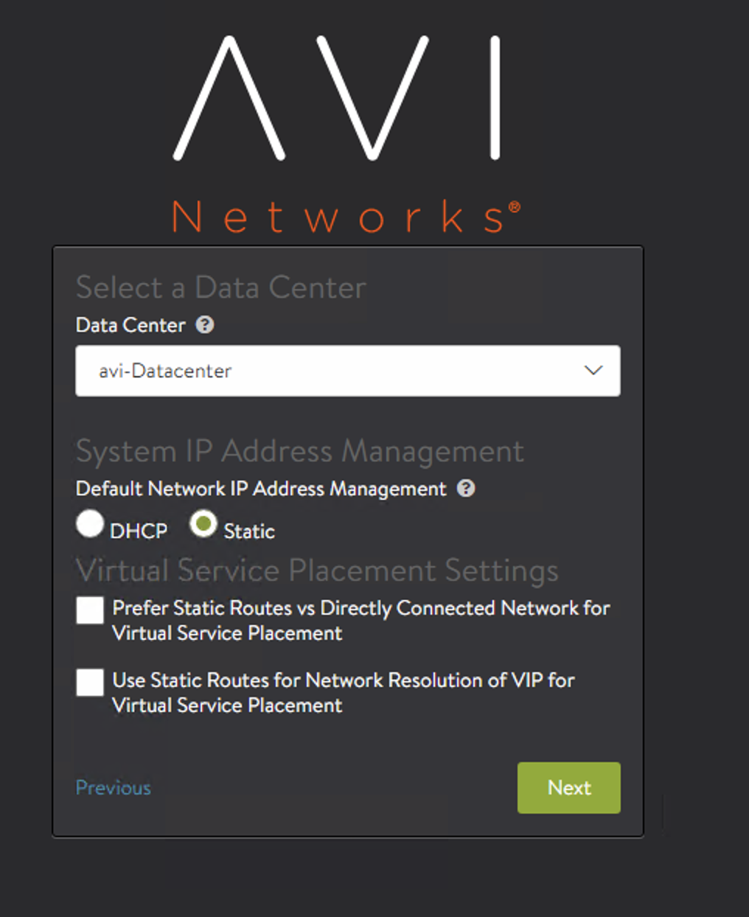
AVI initial setup

Slide 27
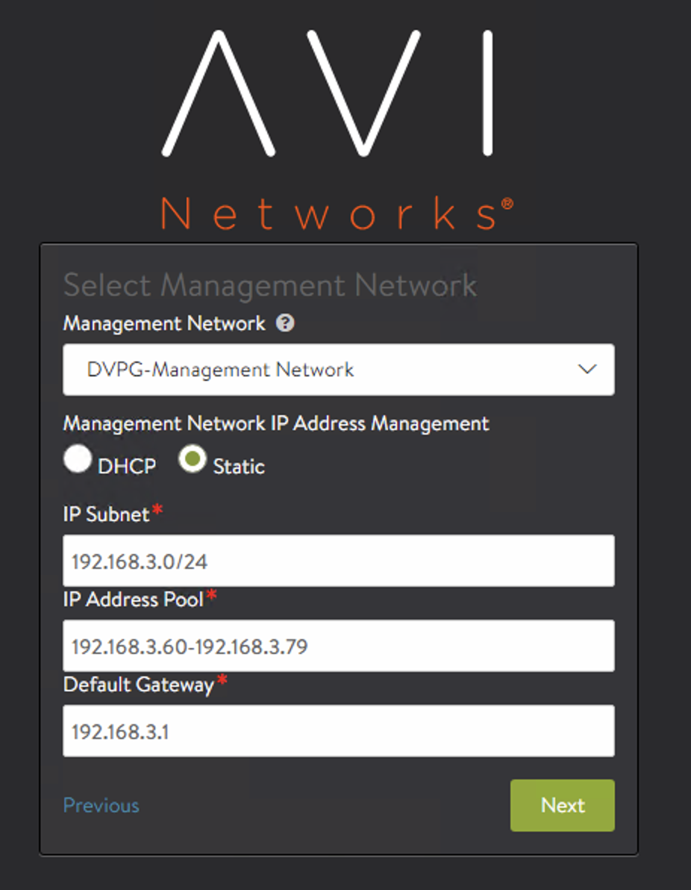
AVI initial setup

Slide 28
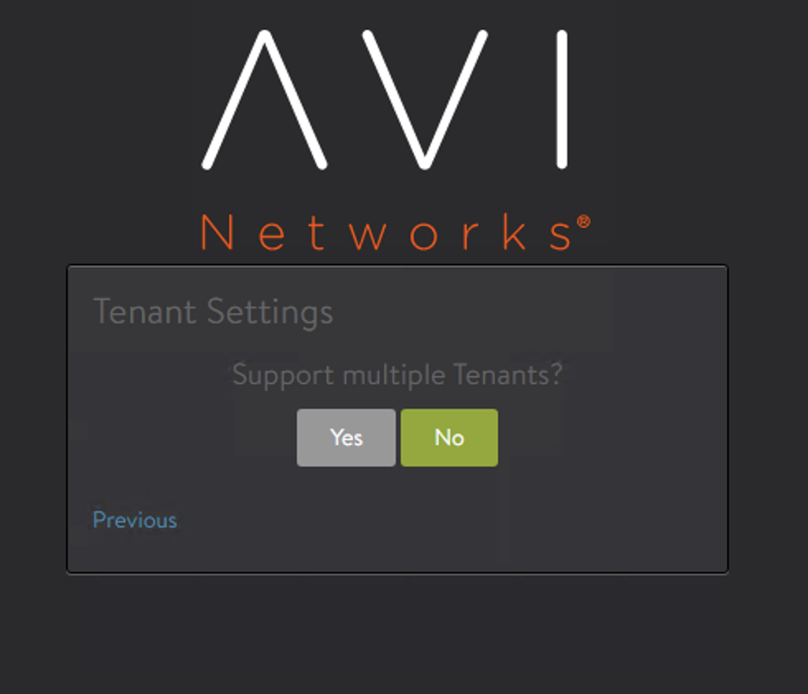
AVI initial setup

Slide 29
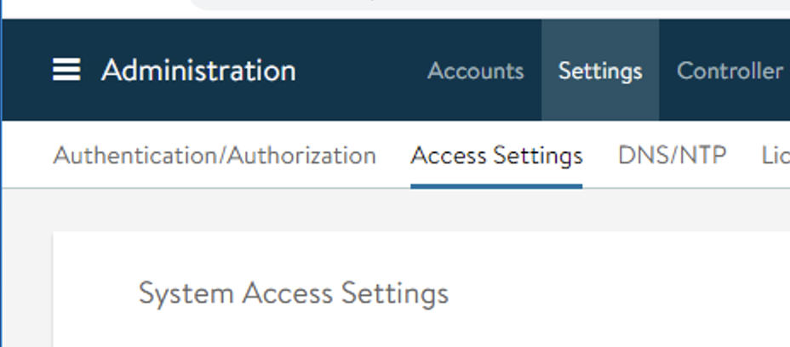
Cert

Slide 30


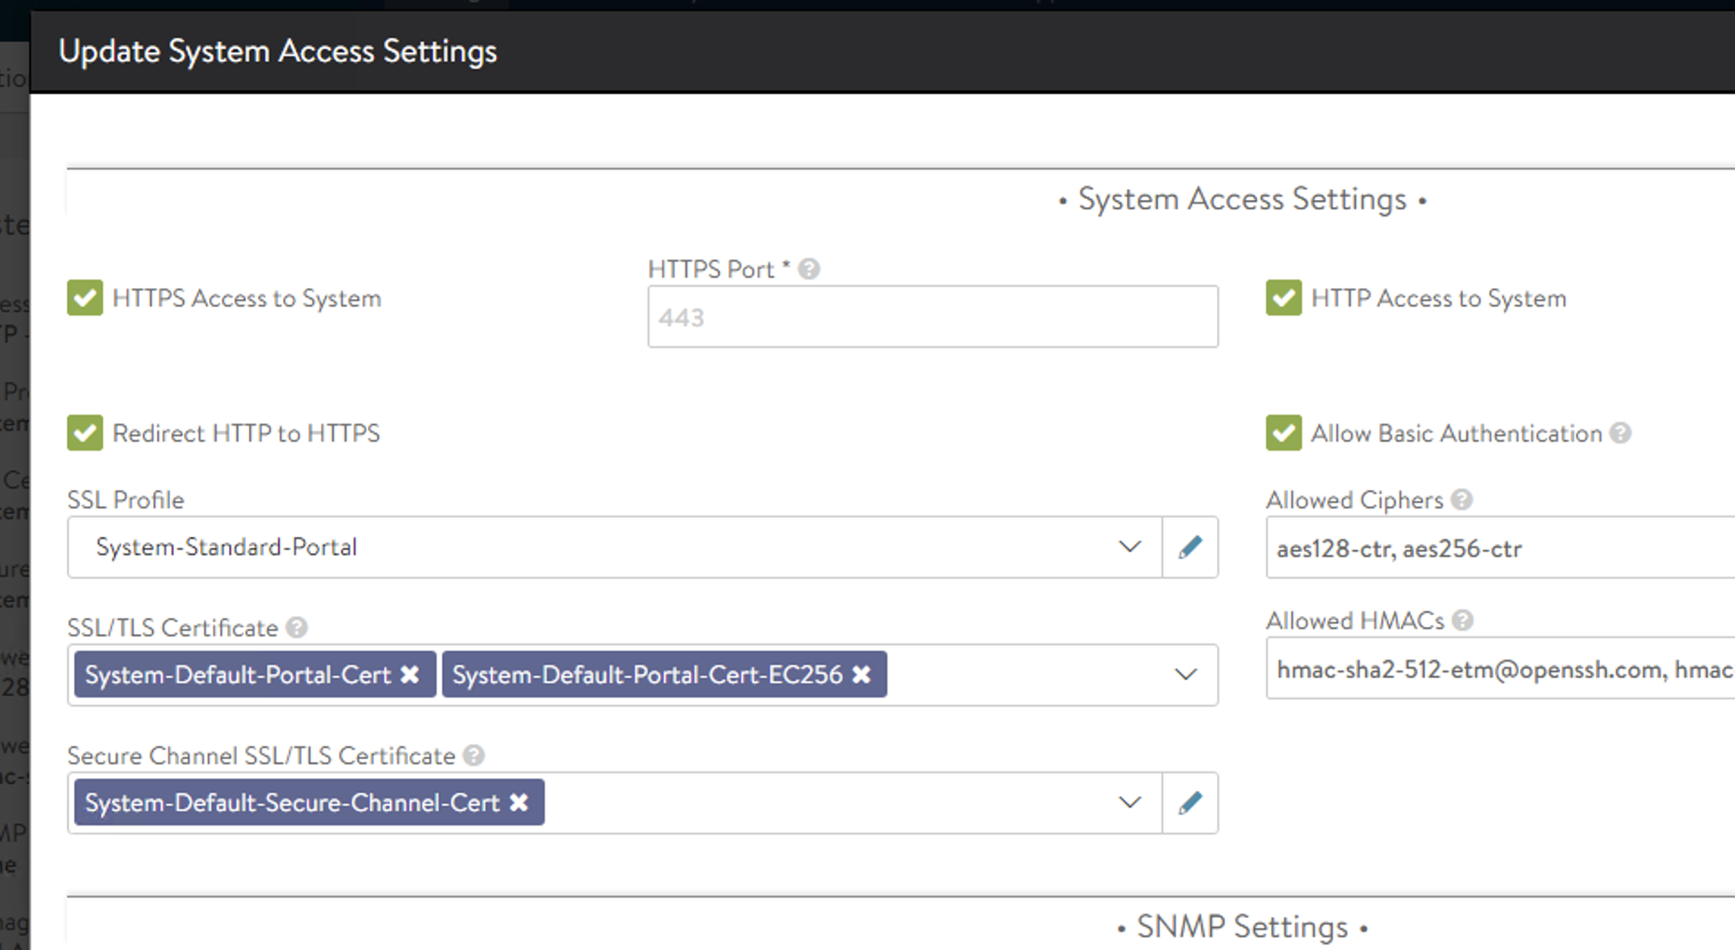

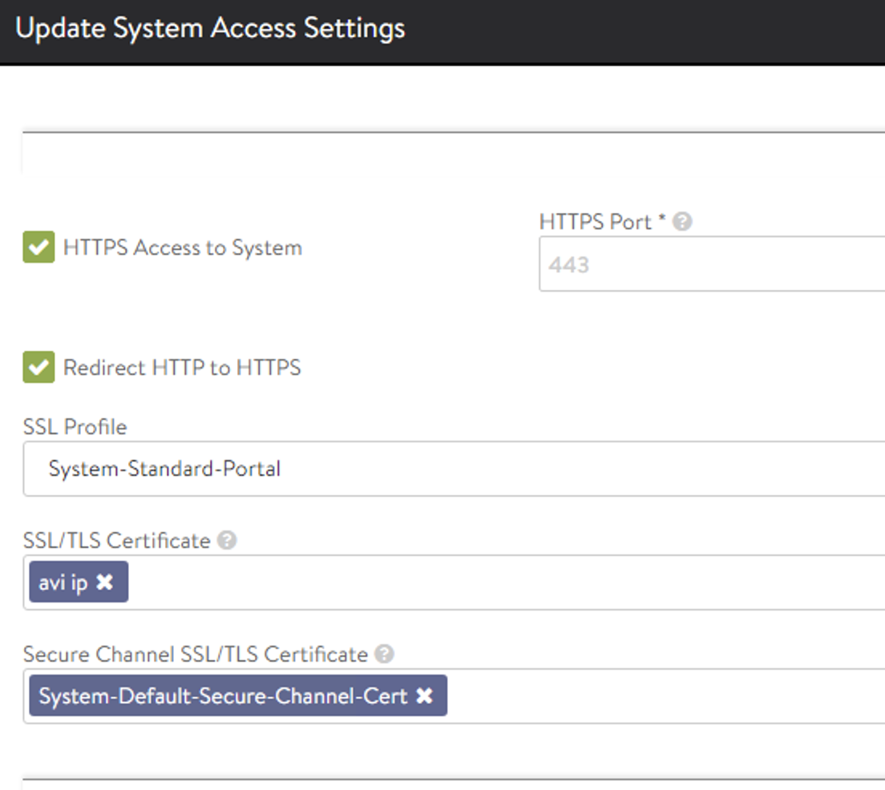
Delete certs to get edit to work in drop down

Slide 31
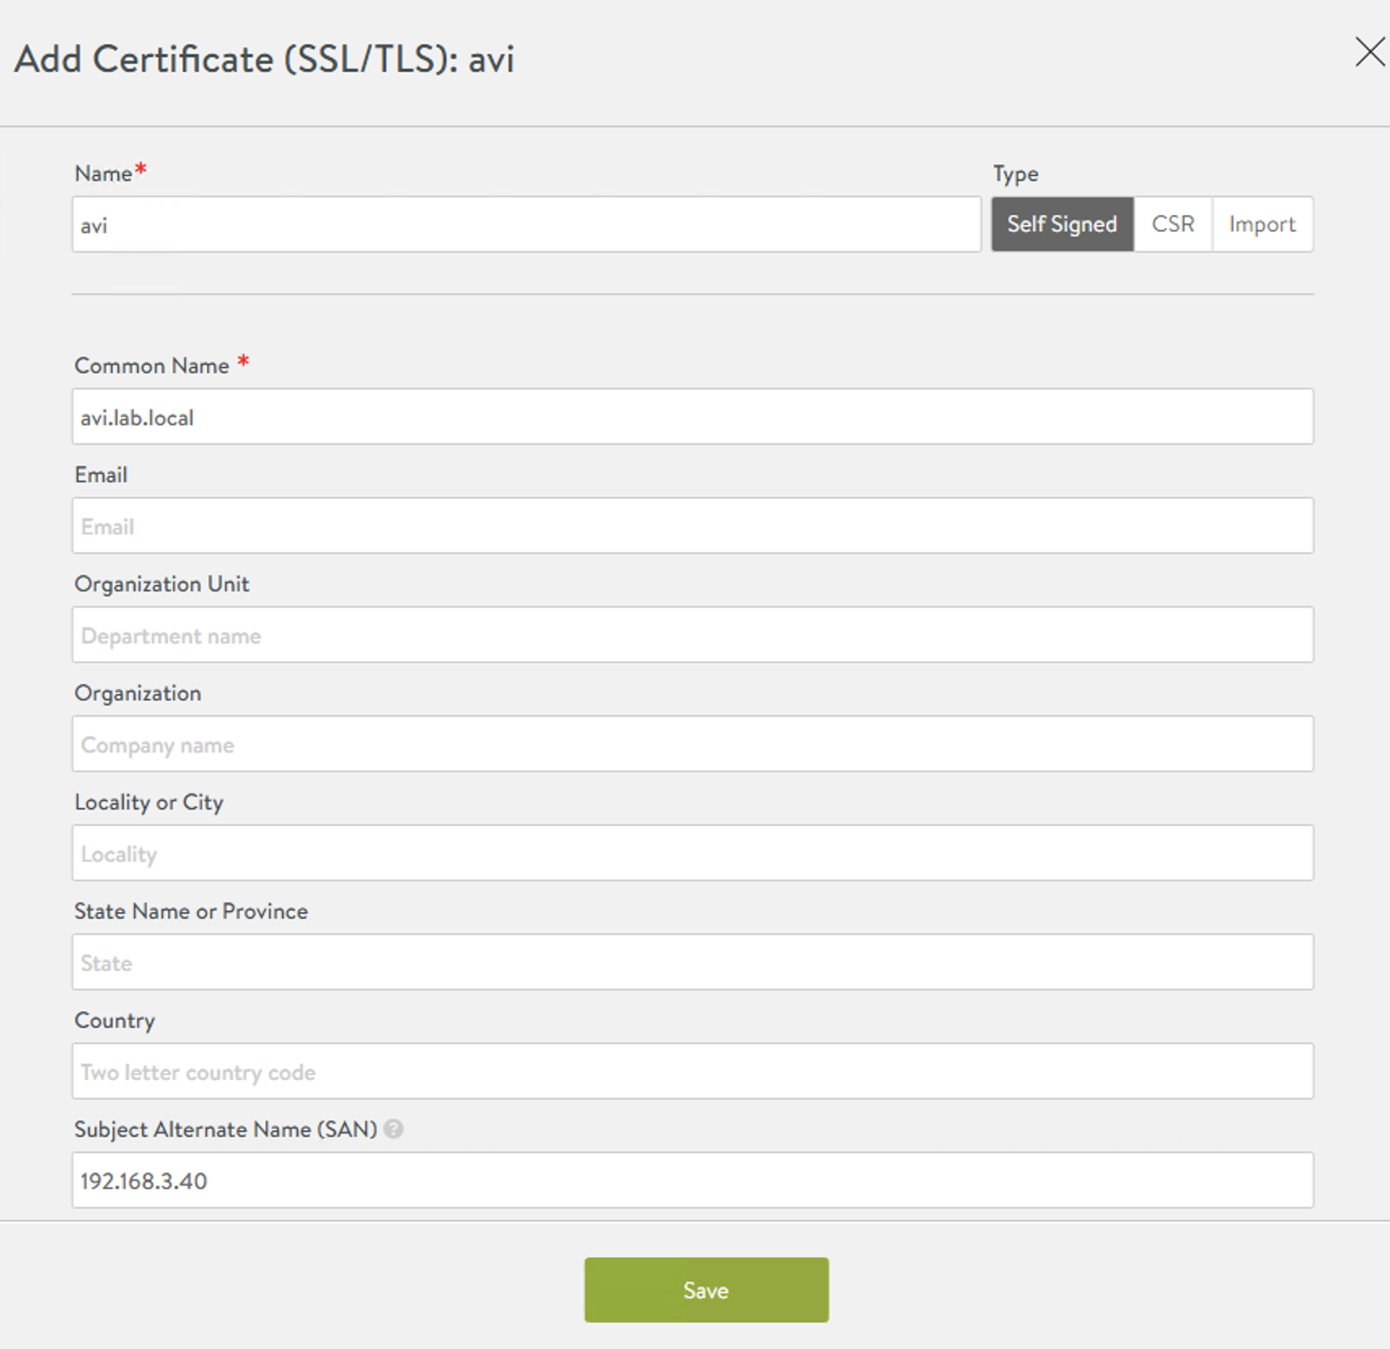
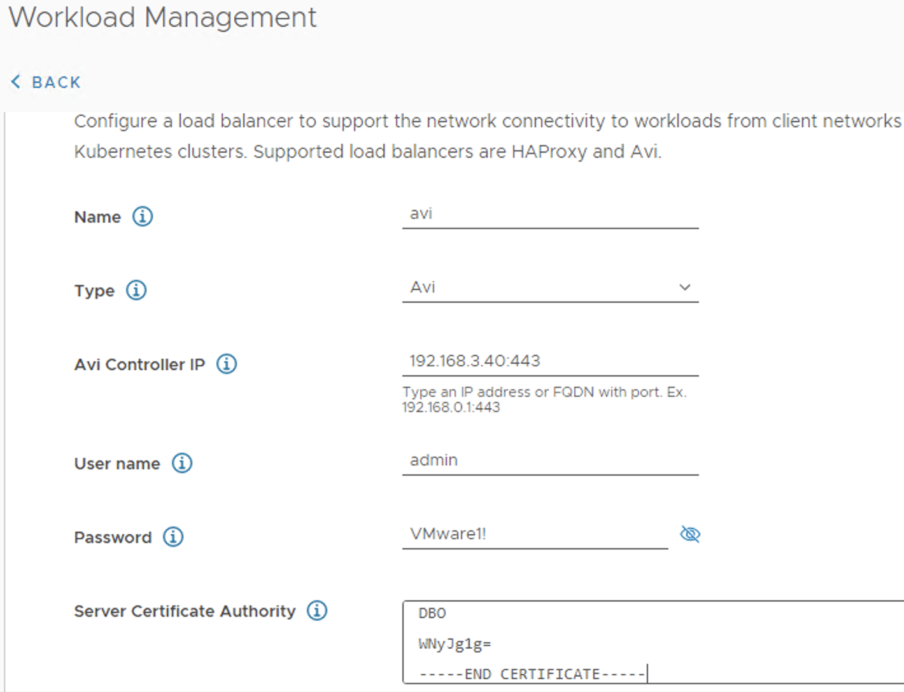
Notice first line and SAN lineand match up with later the WCP enablement

Slide 32
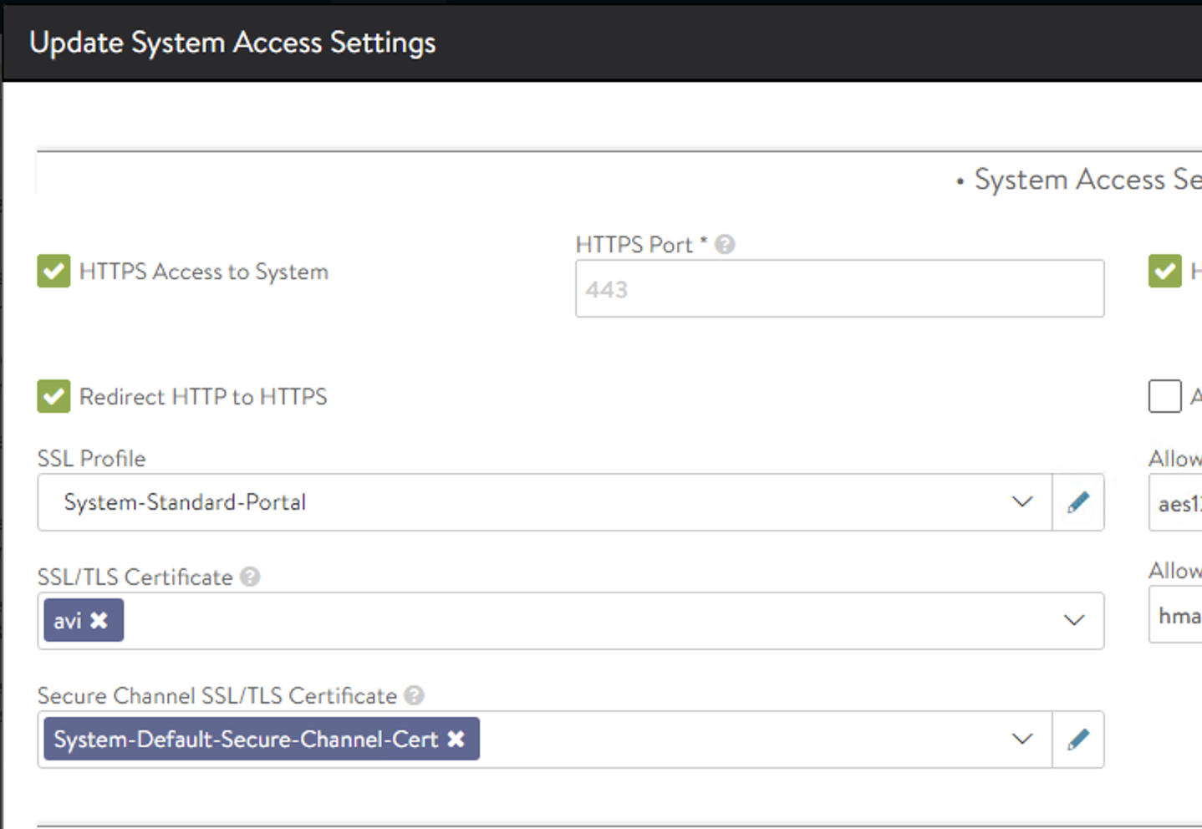

Slide 33
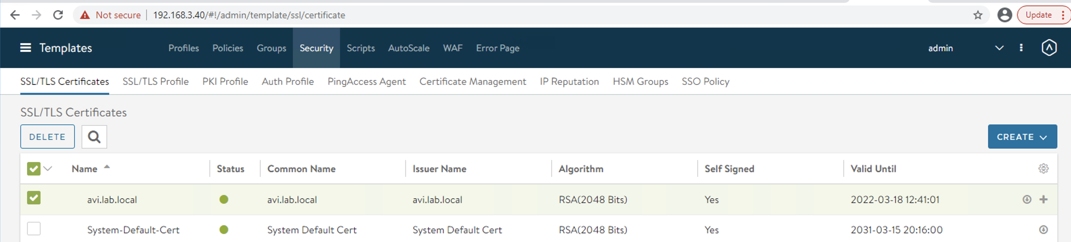
Export cert for later vCenter enablement

Slide 34
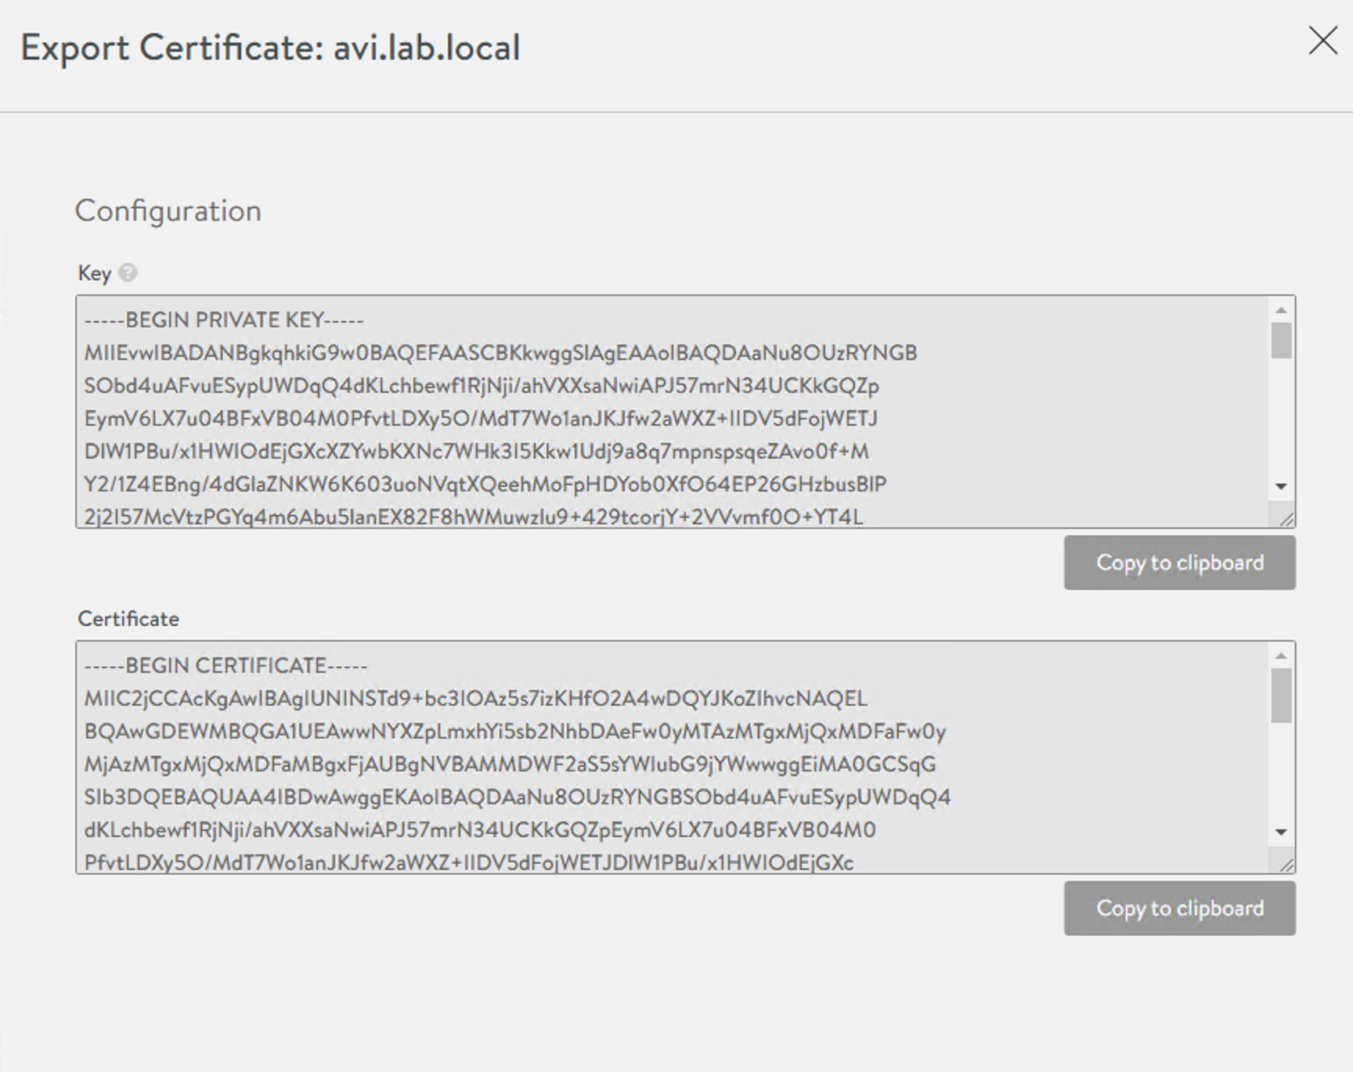
Copy Certificate to clipboard and into note pad

Slide 35
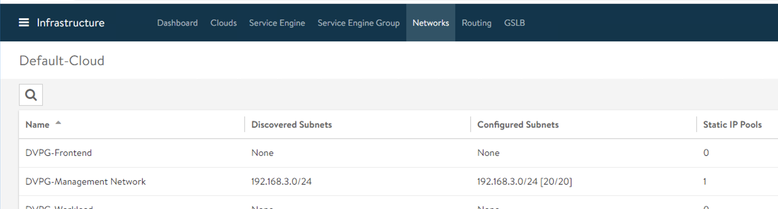
Create front end pool

Slide 36
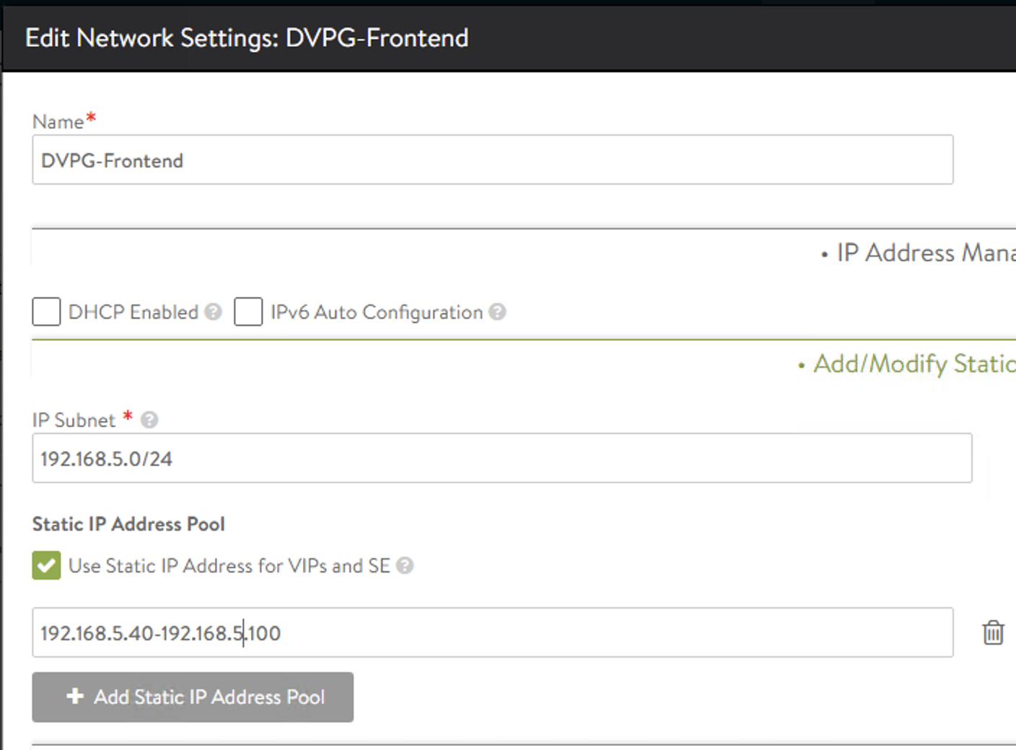
Make sure VIP/SE is selected

Slide 37
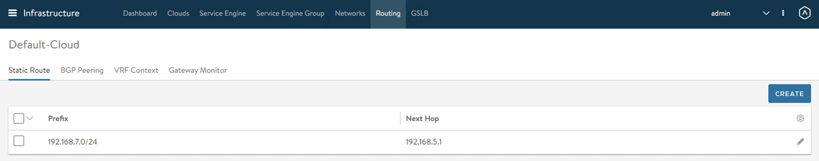
Add route

Slide 38
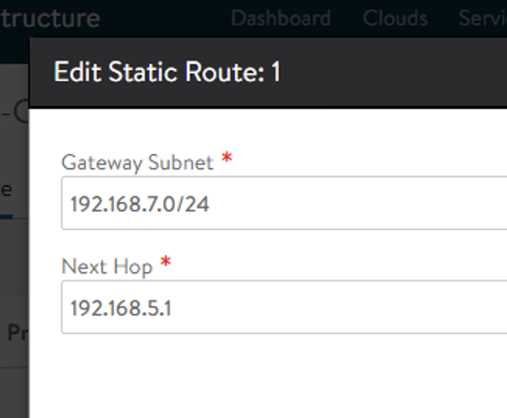
Route back to workload network via frontend on SE’s (they are not on the workload network!)

Slide 39
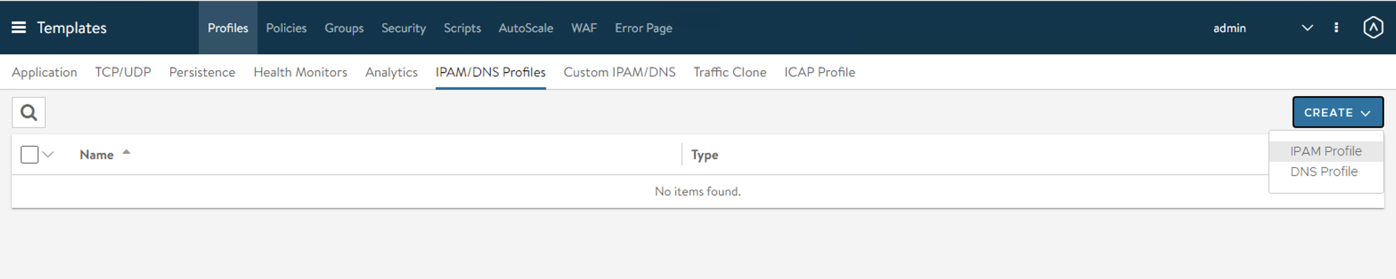
IPAM profile

Slide 40
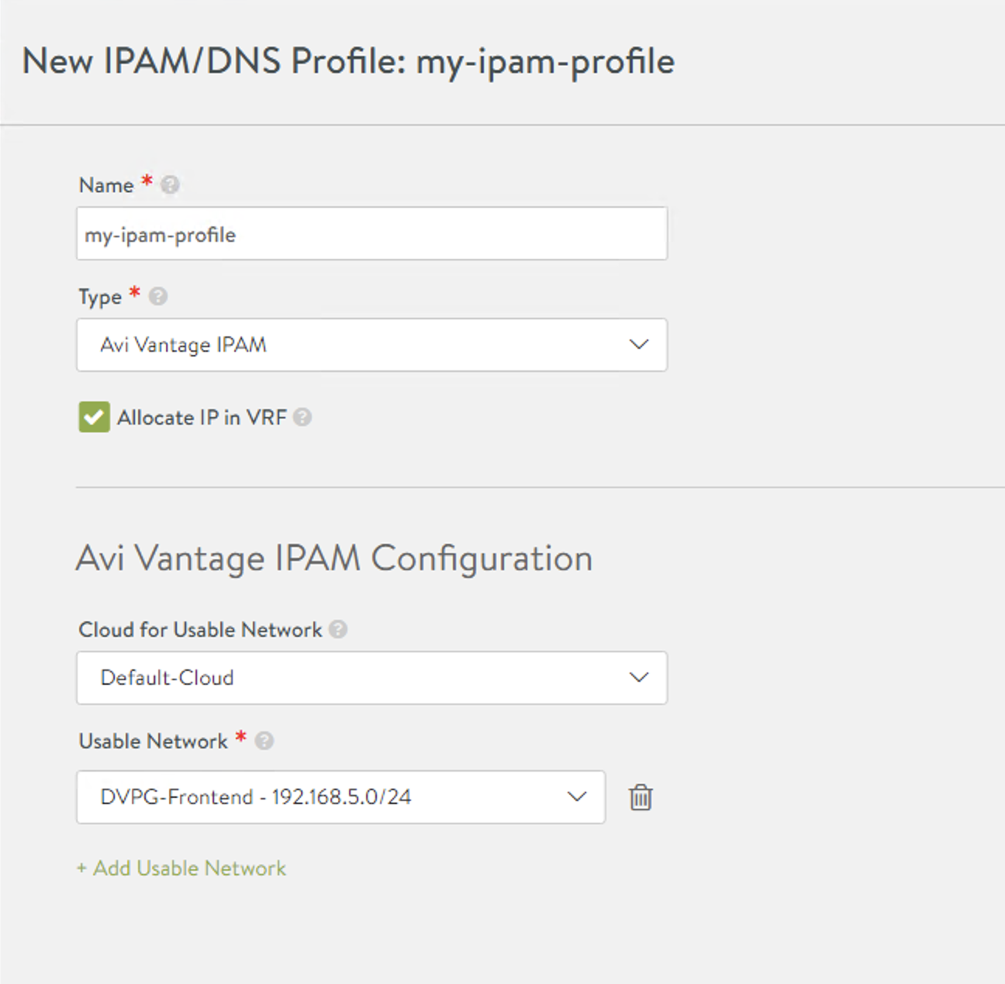
Creae IPAM profile

Slide 41
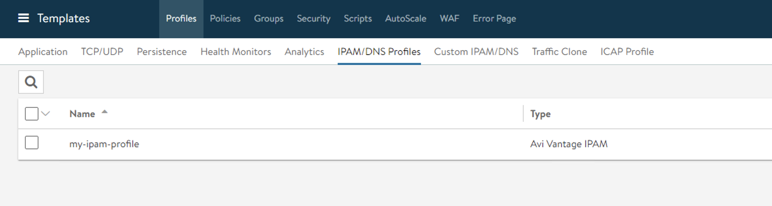

Slide 42
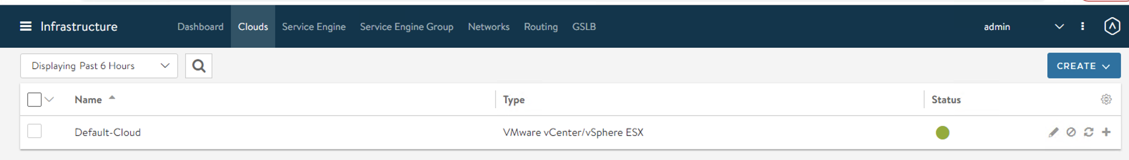
Connect profile with Cloud

Slide 43
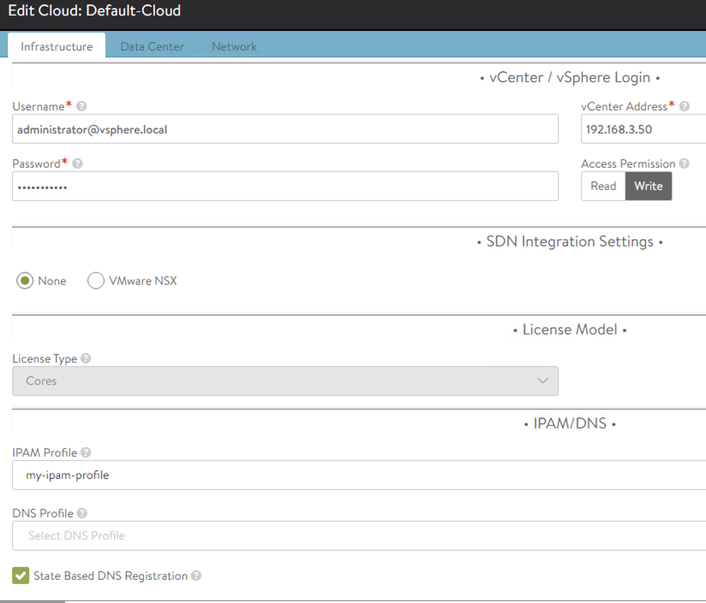
Select the created profile

Slide 44
In vCenter start the WCP enablement

Slide 45
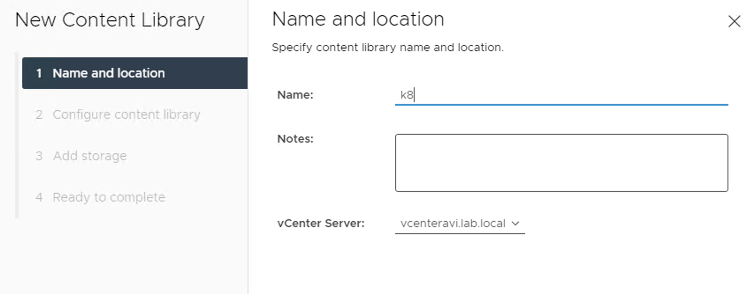
Create Content library of K8 images

Slide 46
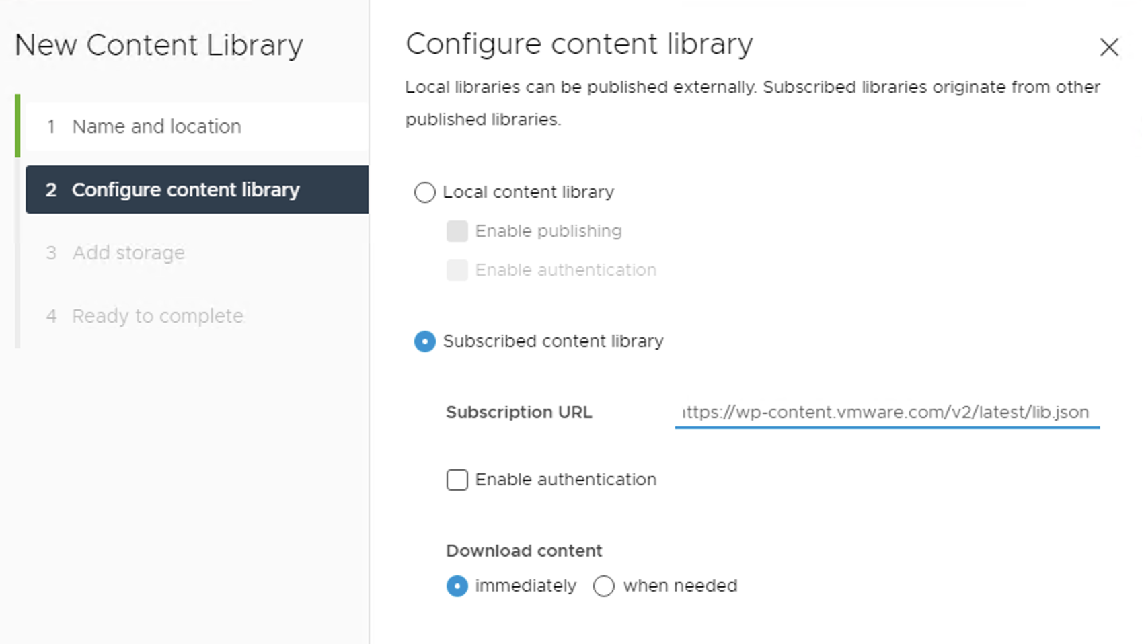
Content library location: https://wp-content.vmware.com/v2/latest/lib.json

Slide 47
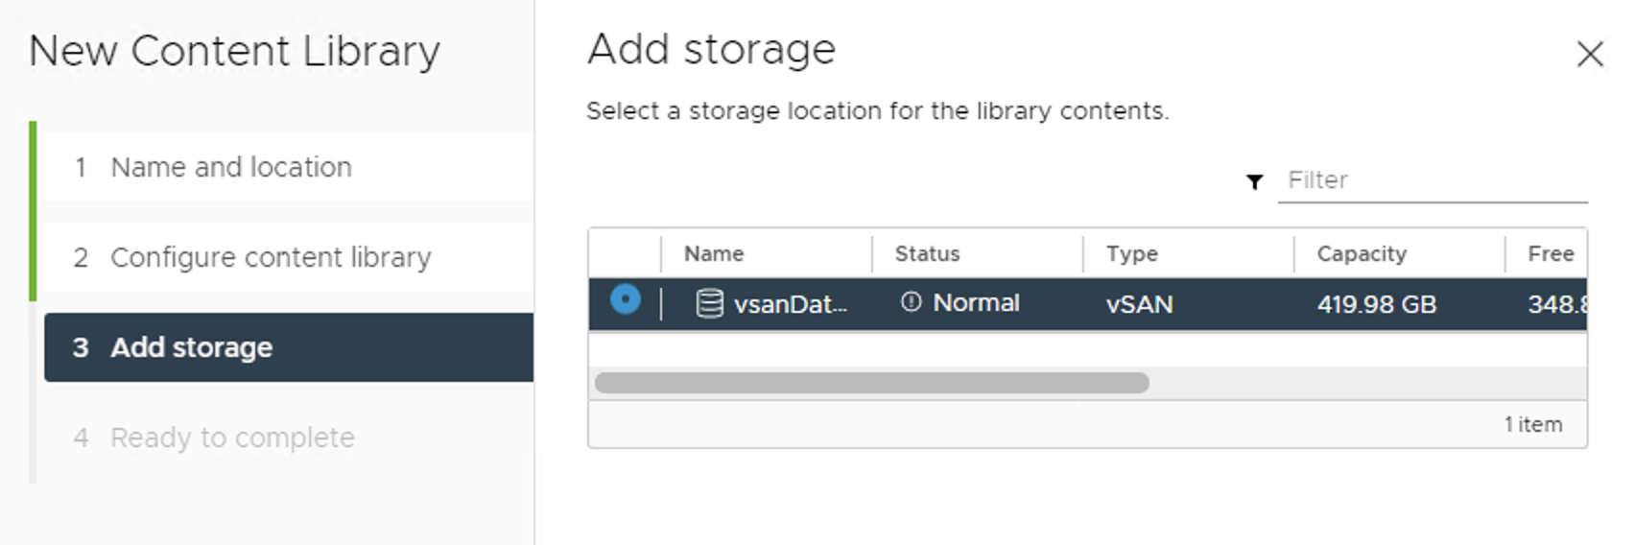

Slide 48
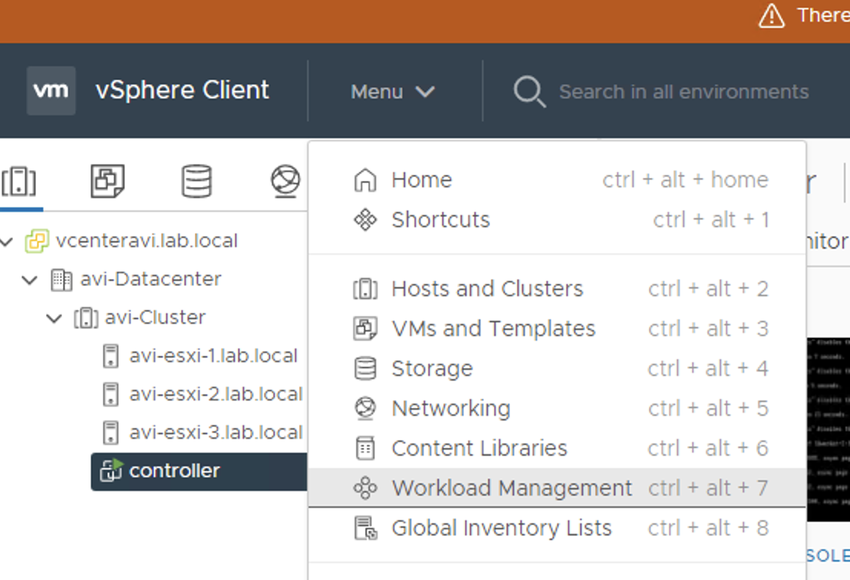
Running AVI controller

Slide 49
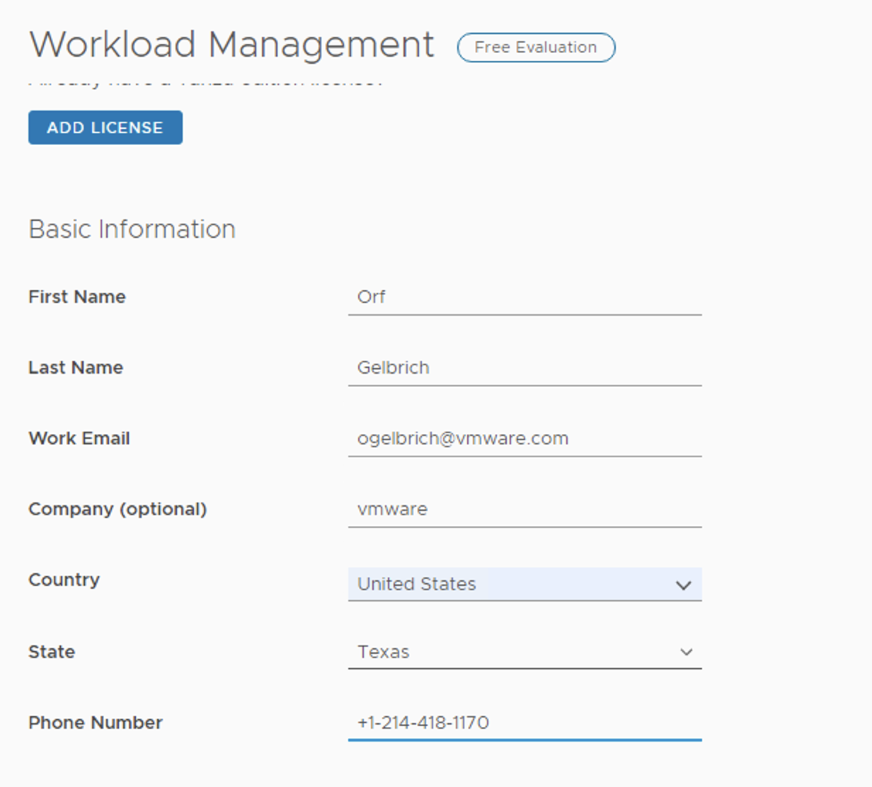
This will result in a 60 temp license

Slide 50
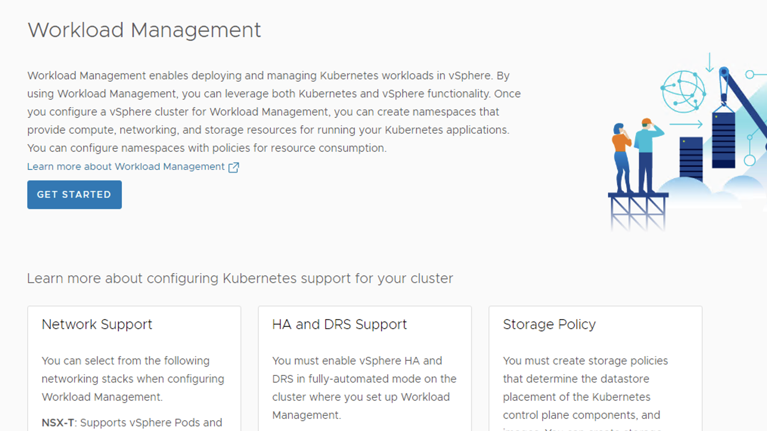
WCP enablement

Slide 51
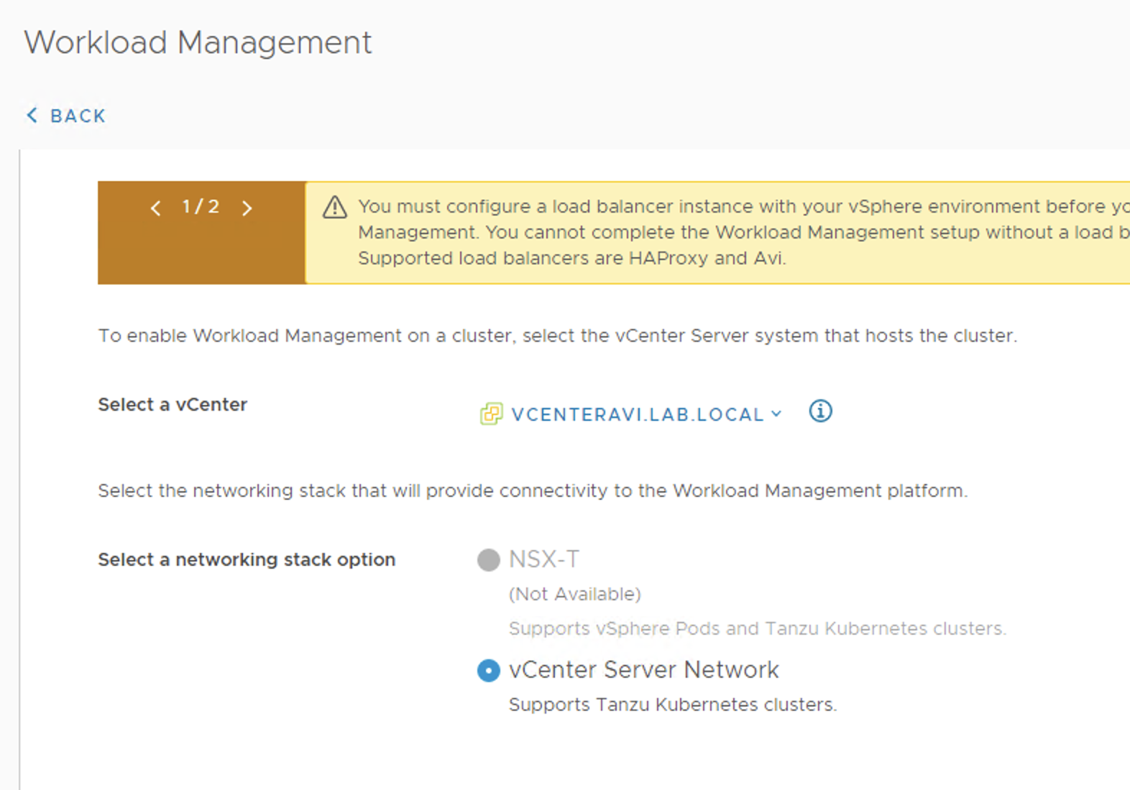
vCenter switch

Slide 52
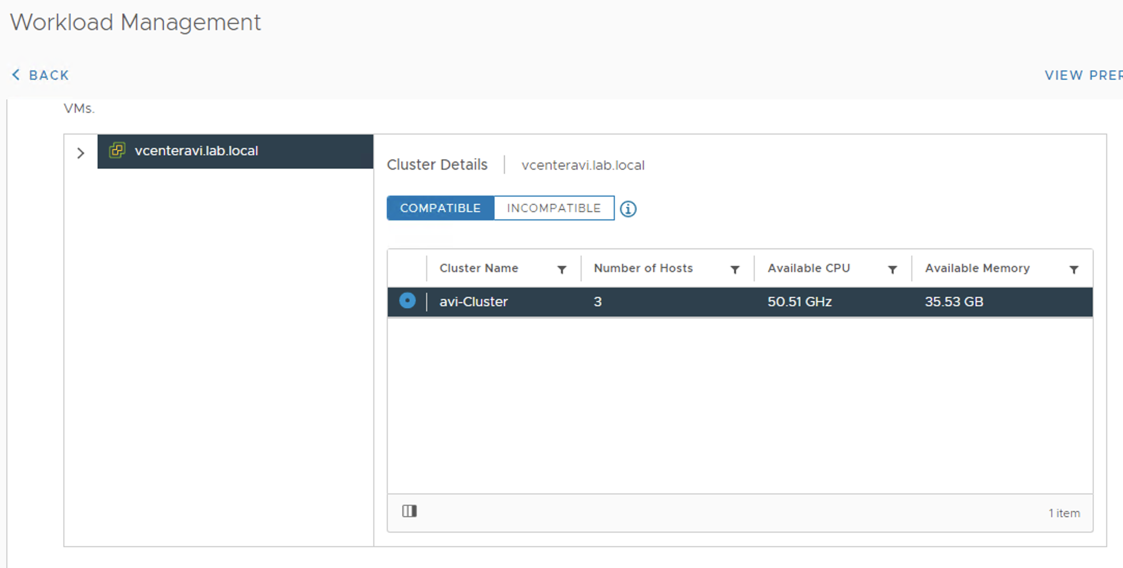
Select vCenter cluster

Slide 53
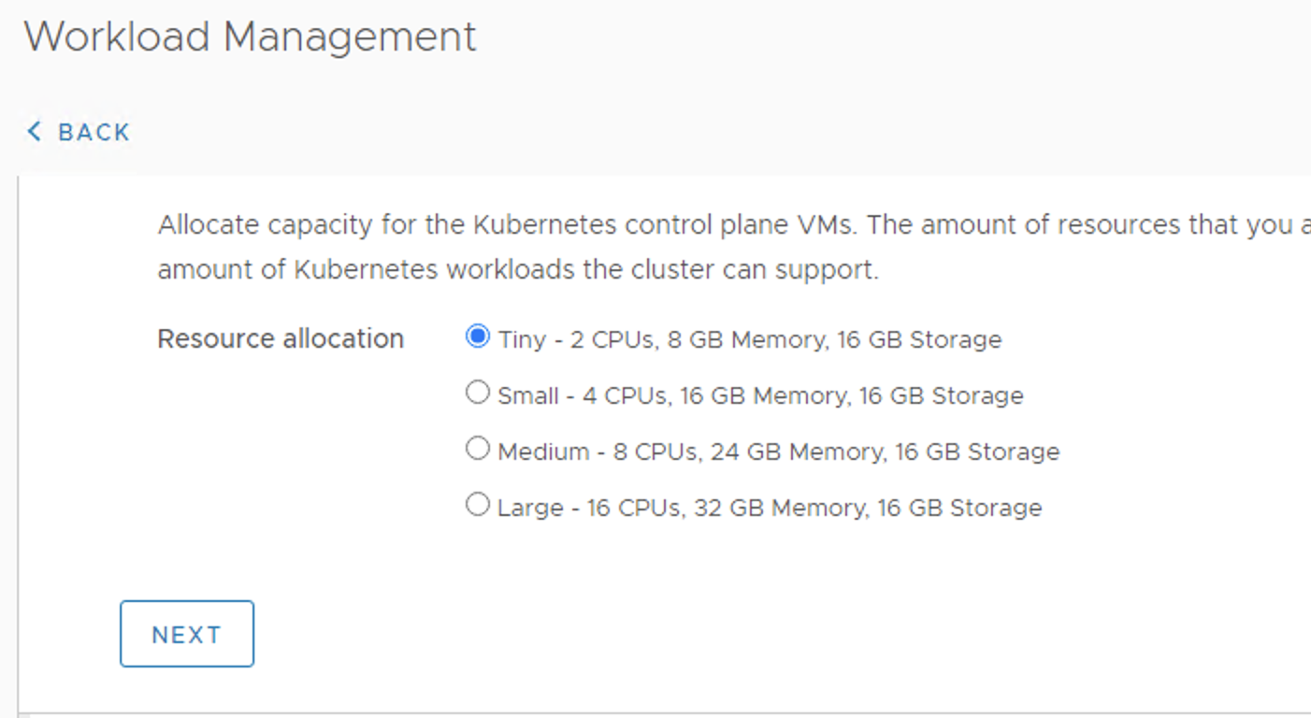
This is a nested POC lab (tiny)

Slide 54
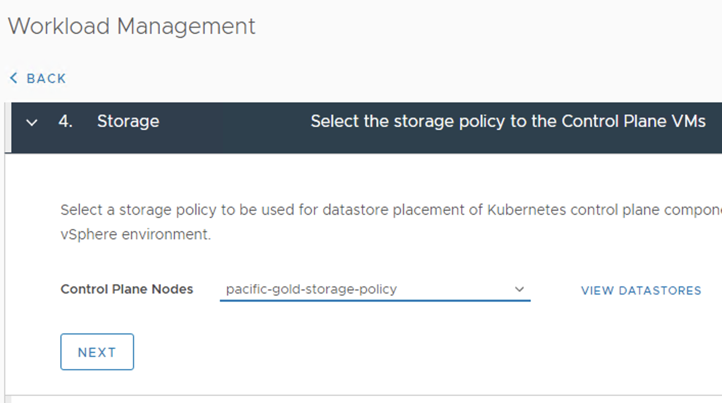
Select the tagged data store

Slide 56
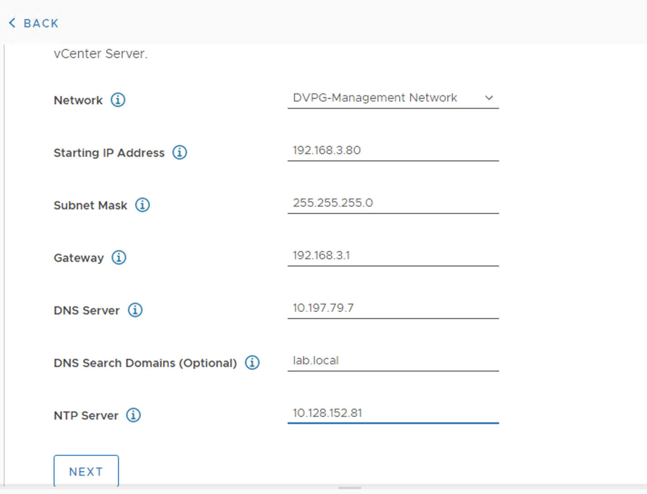
Management Network (.3)

Slide 57
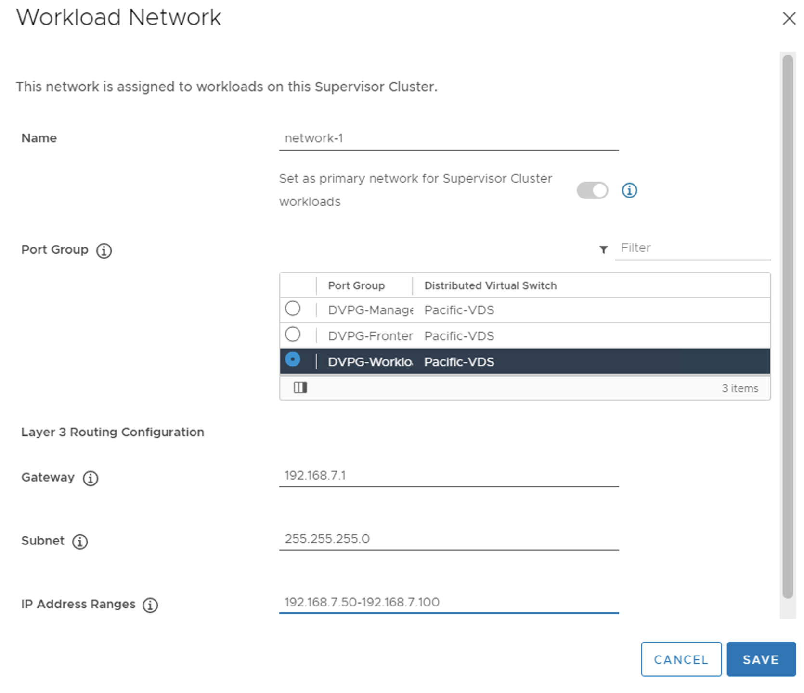
Workload network (.7)

Slide 58

Workload Network (.7)

Slide 59

Add previously created content library

Slide 60

Watch deployment of supervisor VM’s

Slide 61
Watch vCenter log
ssh to vCenter ssh root@192.168.3.50
shell
tail -f /var/log/vmware/wcp/wcpsvc.log

Slide 62
Watch connection to AVI (Trouble shooting connect to AKO pod on sup vm)
ssh to vCenter ssh root@192.168.3.50
shell
cat /usr/lib/vmware-wcp/decryptK8Pwd.py
Ssh to IP and use password from above command
kubectl delete pod/vmware-system-ako-ako-controller-manager-85bb7dd4-hk26q -n vmware-system-ako
kubectl get events -n vmware-system-ako -w
kubectl get pods -A | grep ako
kubectl logs -n vmware-system-ako pod/vmware-system-ako-ako-controller-manager-85bb7dd4-wnhrg
kubectl get secrets -A | grep -i ako
kubectl describe secrets/avi-secret -n vmware-system-ako
kubectl get secret avi-secret -n vmware-system-ako -n vmware-system-ako -o jsonpath='{.data}'
echo "Vk13YXJlMSE=" | base64 --decode

Slide 63
Desired results in vCenter log
2021-03-20T04:21:17.332Z info wcp [opID=605520eb] Sessions available: 998 2021-03-20T04:21:17.332Z debug wcp [opID=vapi] Validating output 2021-03-20T04:21:17.332Z debug wcp [opID=vapi] Request processing complete 2021-03-20T04:21:17.332Z debug wcp [opID=vapi] Sending response with output {"output":null} 2021-03-20T04:21:18.667Z info wcp [opID=605520b1-domain-c8] API server configured successfully. Publishing IP addresses.

Slide 64

Communication with AVI is working it is creating he Service Engines (SE)

Slide 65

Running Supervisor Cluster with API endpoint

Slide 66




Results in AVI

Slide 67

Service Engine (SE) Max Error

Slide 68


Increase Service Engine (SE) count(Possible)

Slide 73
AVI LICENSE
AVI vault license
==================
https://vault.vmware.com/group/vault-main-library/document-preview/-/document_library/6KC5yhh3TpWl/view_file/49534770
cat f3ffca5b5e724c55ac26afa677811ff3.yml
-----BEGIN PGP SIGNED MESSAGE-----
Hash: SHA1
cores: 20
backend_servers: 1000000
created_on: 2020-07-07 18:03:50
days_valid: 730
enforced_params:
- cores
last_update: 2020-07-07 18:03:50
license_id: f3ffca5b5e724c55ac26afa677811ff3
license_tier:
- Avi-Enterprise-18
license_type: Trial
name: VMware <INTERNAL> - 1 Year - 20 Core (vCPU) - Evaluation License
customer_name: VMware Internal
start_on: 2019-07-31 00:00:00
valid_until: 2021-07-30 00:00:00
version: 1
-----BEGIN PGP SIGNATURE-----
Version: GnuPG v1
iQIcBAEBAgAGBQJfBLkGAAoJEGvzPn2hCUfBmUwP/3zwPTZw+7Rt4g3ar4JXygjm
1pdf9pyyo15FhDP0FFTHvYNeSs0BdHh4tB4h05ZO+ZpIg2rJ/hxJ56VrhIVPhmIk
FOb+UrYDTbDPShh6oXQ5nuDe77ydxNbbAG8vxbT673LgrX1npg9K7Gkvsz55DDh+
aCZBeZkitZVftbFRIkk9w0ysfwtcDsLkvzOS+jyU6cTMLOlNceOGn6hpELbkWLYR
L/qpdllEYdp5vSl1kk5hcyQgUWzw7g9Lti4KhhyH7Ooktv8l33JhT6O5M8OGNomX
SvSC1hCeKS8j49ZBLL85+Tg2iG2+ulSY+1j2NFyWvEwDYTK7W/YWqxIrB5bg7VcS
onyIdLZl8P3tAbI2602SIMWEIQIV88vAmetkJJNnM8GBgmcjvkUQqMi0Suq8G94b
Xfk7nIjpteQh3eNPY3zGndTNtHgO53WTEFUHx4JNelIaXhlQUxTVWPoUGBpGy2Qa
LAxdny30O23ccD9KYtQF6/ancVE/ozwIywarcWz5uMMZlQD/8WJCf4GL4lenSPUR
3cF24u1KJNsfu0xGWFUMIWR34B7gfGKnCqVwNm+Kvj0OT439hHbUX2b30rd8yKA2
mKHwLfeXqnGfwdCiUVTSqQbtaiGI79bHv2lqWLLX7IjRYgDPEceNMu3YB7tLvirE
vF9aE4umQYZnAFWM2dQI
=atNm
-----END PGP SIGNATURE-----

Slide 74

Not sure where that fits in?

